Slide 1
Clinical Neurology Teaching Course
Kerala Association of Neurologists
NeuroRadiology QUIZ
DECEMBER 12/2015
dr suresh chandran cj

Slide 2
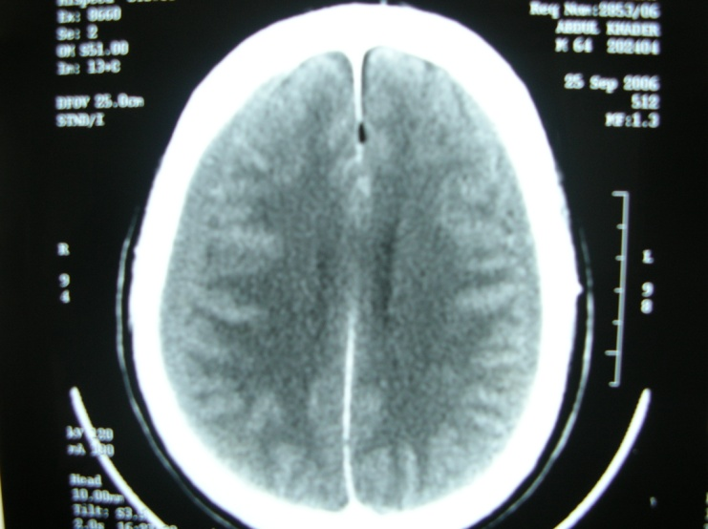
Case 1. 55/M Acute headache .Diagnosis?

Slide 3
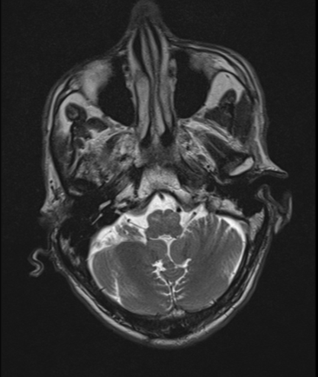
Case 2. Identify the radiological abnormality
What are the possible causes?

Slide 4
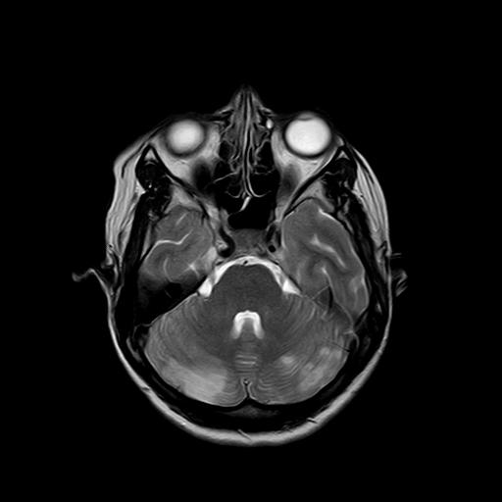
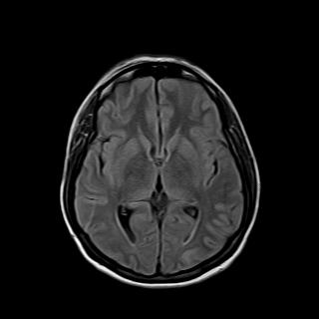
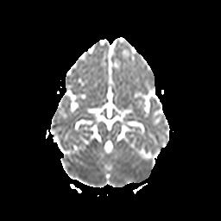
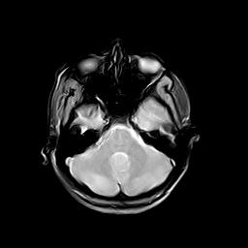
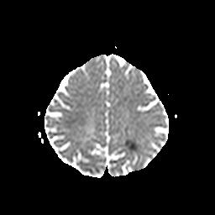
Case 3. 26/F A/C onset headache, minimal right hemi paresis

Slide 5
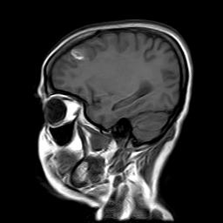
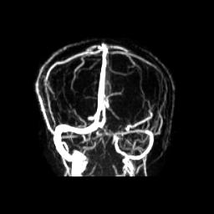
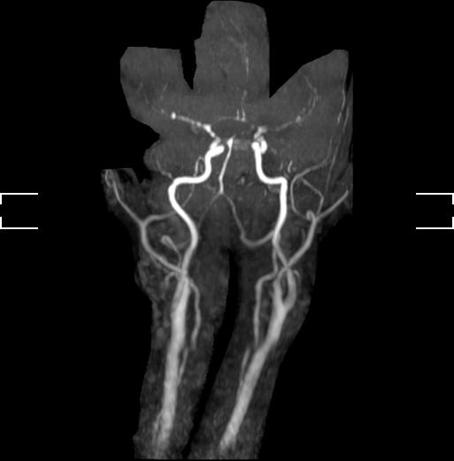
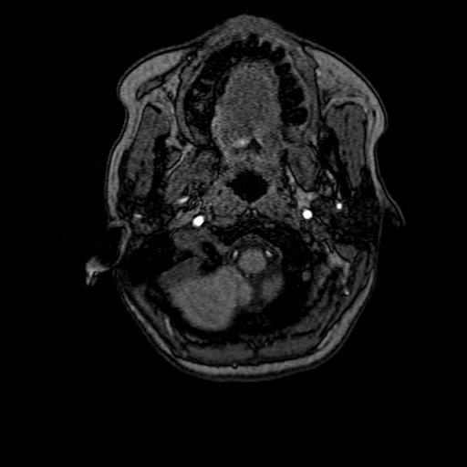
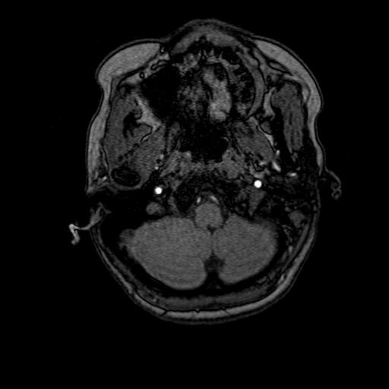
Case 3. What is the diagnosis?

Slide 6
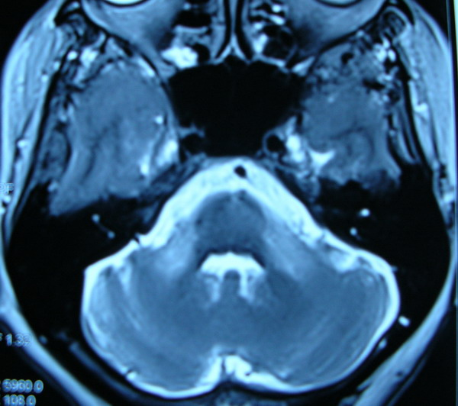
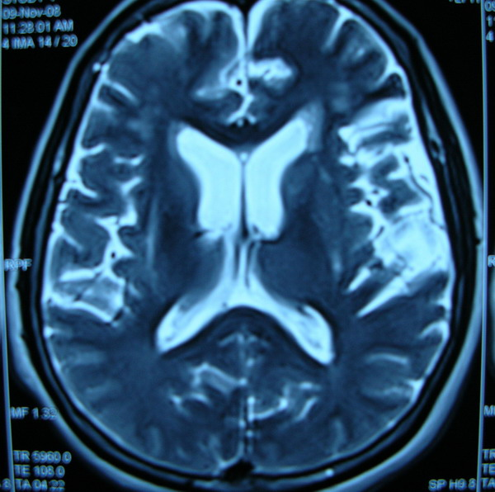
Case 4. 60/M C/c progressive symmetric parkinsonism
Identify the signs
What is the diagnosis?

Slide 7
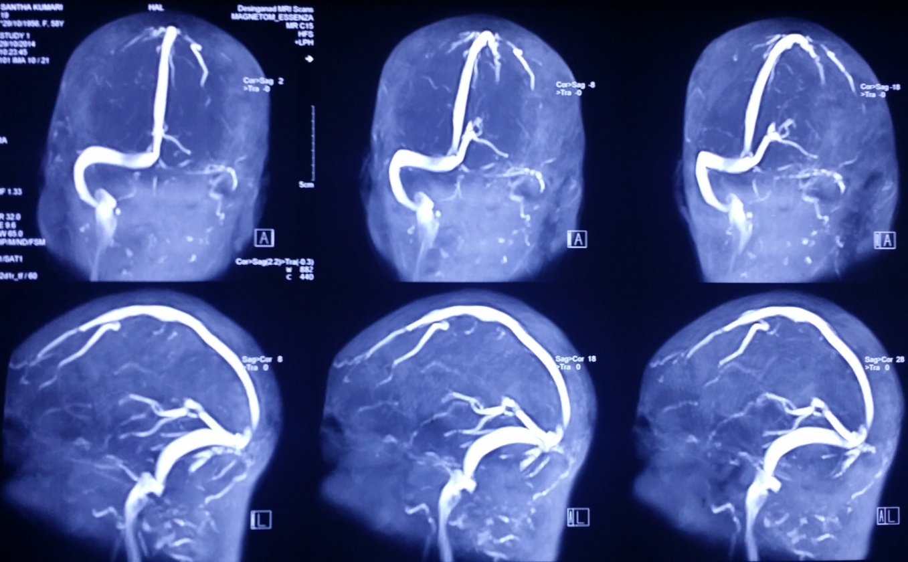
Case 5. 35/f 1 month h/o headache
Identify the radiological sign
What is the diagnosis?

Slide 8
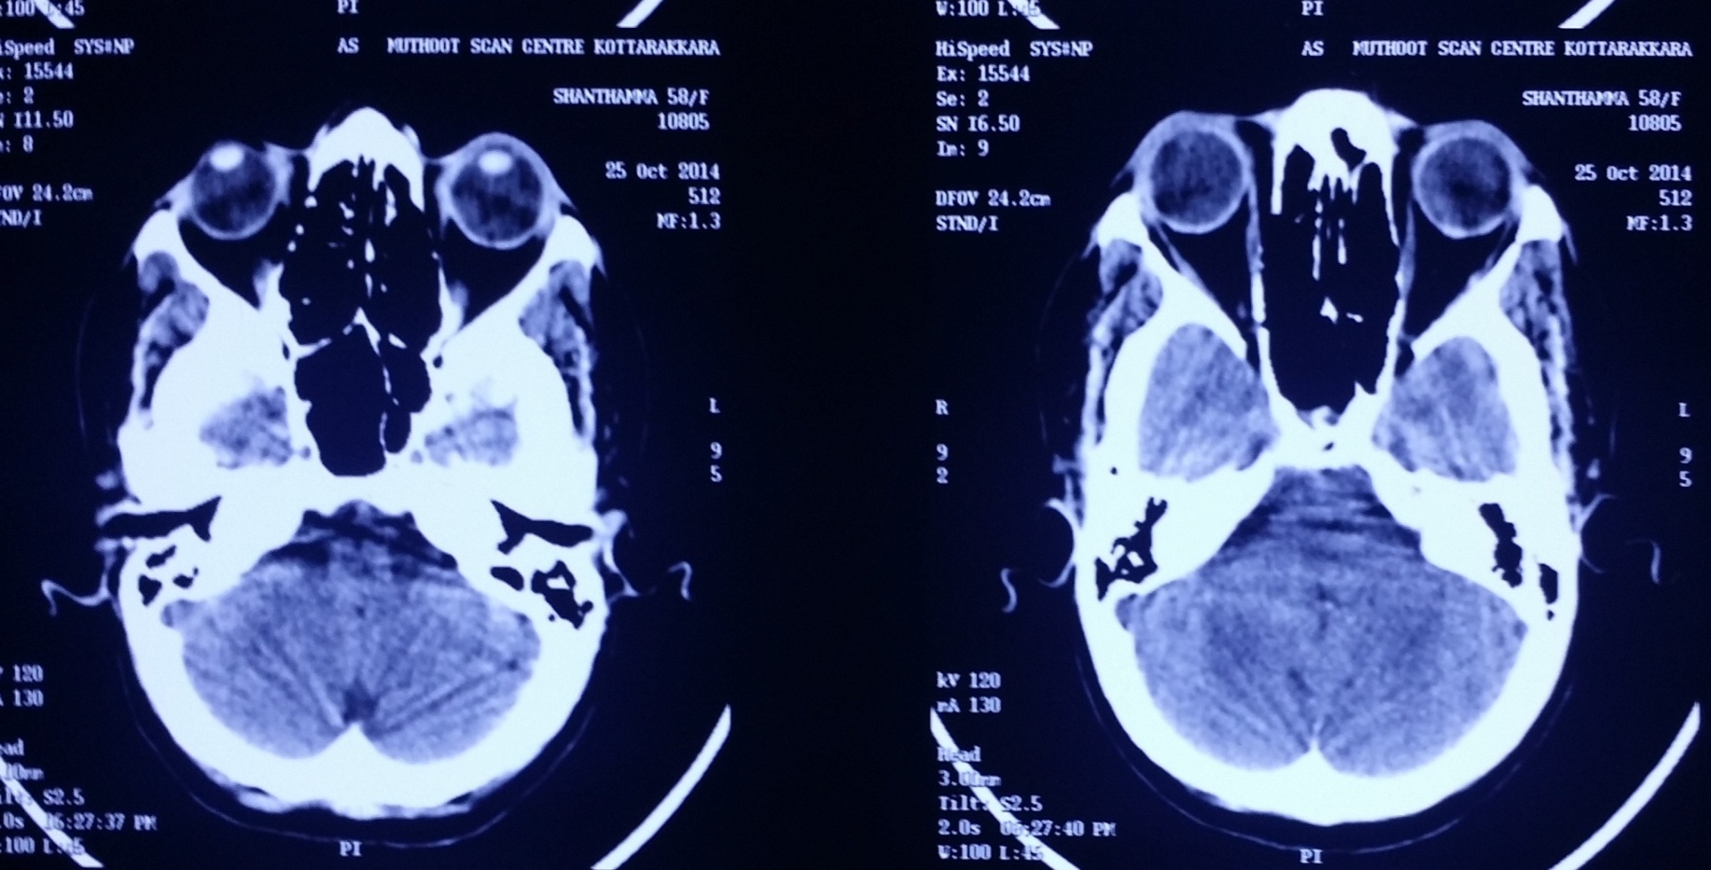
Case 5

Slide 9
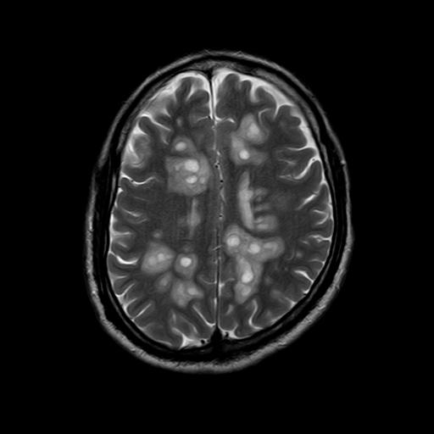
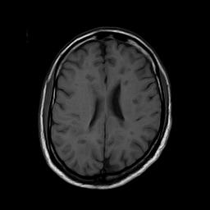
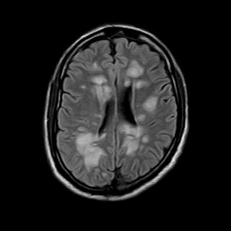
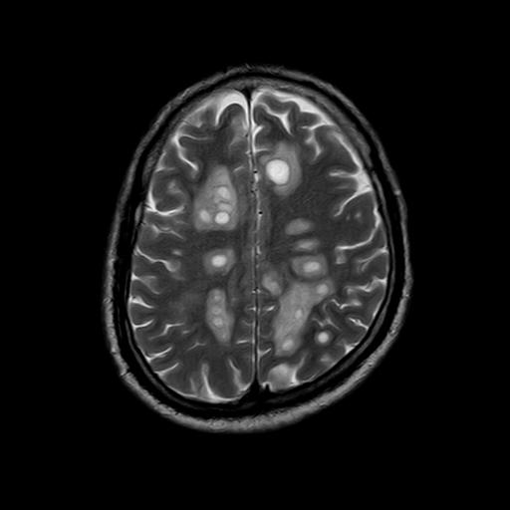
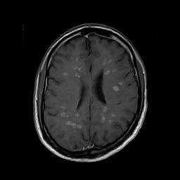
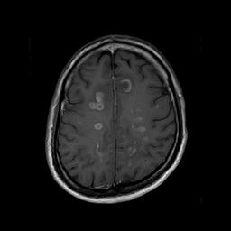
Case 6. 3 weeks h/o gait disturbance slowness of mentation Bipyramidal signs, subcortical dementia Identify the radiological sign. what is the diagnosis?

Slide 10
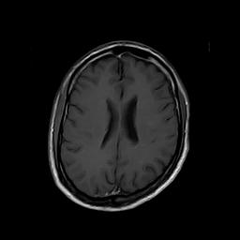
Case 6. After Treatment

Slide 11
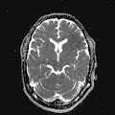
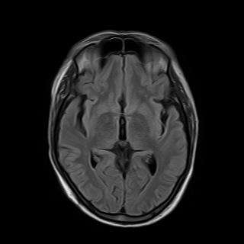
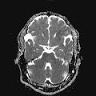
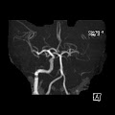
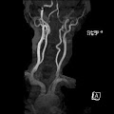
Case 7. 45/M A/c right hemiplegia

Slide 12
Case 7. Identify the signs What is the diagnosis?

Slide 13
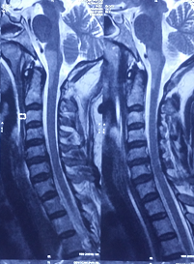
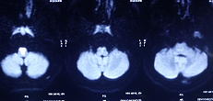
Case 8. 38/M A/c onset quadriplegia
Identify the radiological sign?
What is the diagnosis?

Slide 14
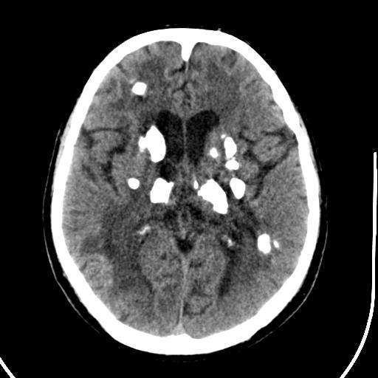
Case 9. 35/F ,5 yr h/o progressive ataxia tremor spasticity What is the diagnosis ?

Slide 15
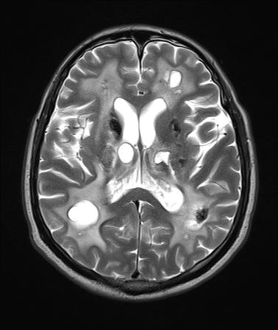
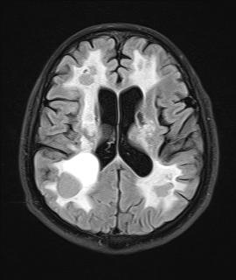
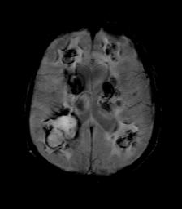
Case 9

Slide 16
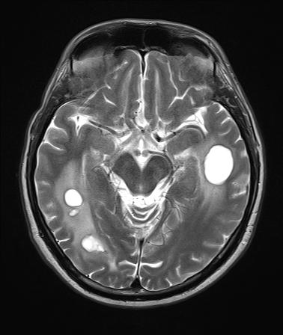
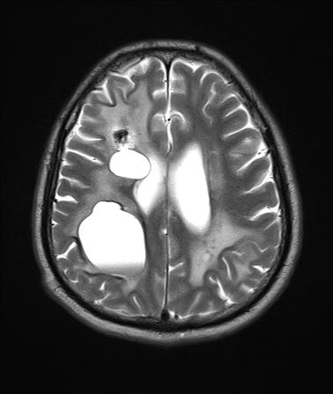
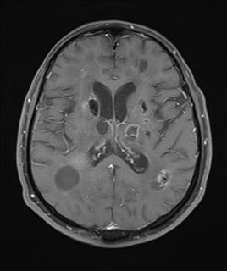
Case 9

Slide 17
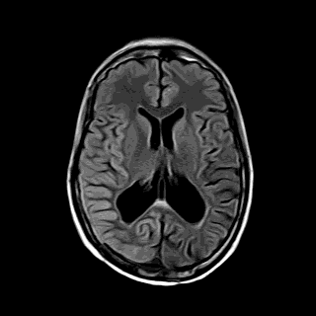
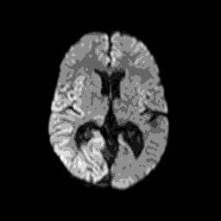
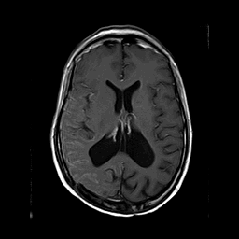
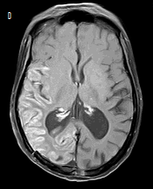
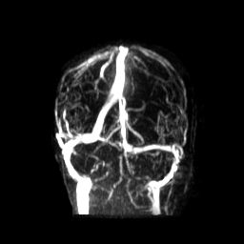
Case 10.
30 year old man
3 weeks h/o right sided headache. No fever
2 weeks left focal to secondary generalized seizure
Post op pineal tumor 10 y back Post RT
Infrequent seizures earlier ,was on gardenal 60hs and eptoin 100 bd
O/E left hemianopia Left todds palsy
What is the diagnosis?

